Slide 1
Biologically informed graph neural networks for drug effect prediction
Jin Yan

Slide 2
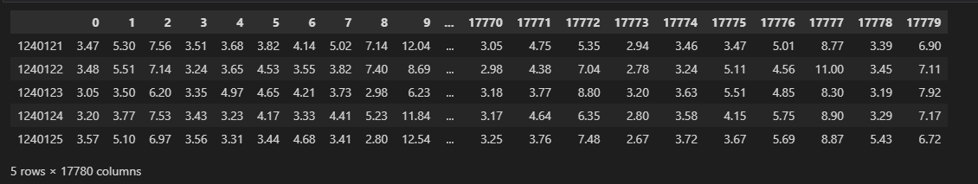
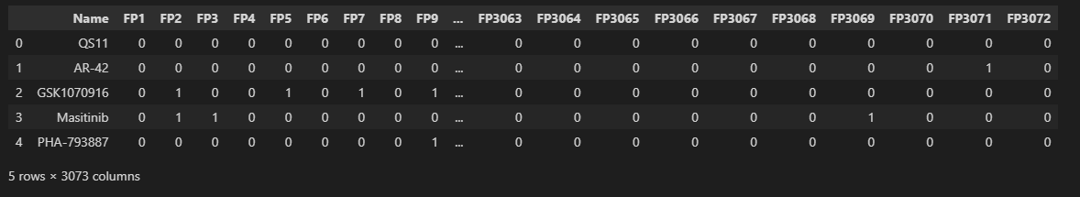
Gene Expression Data
Drug Data

Slide 3
Goal: Using Graph Nuerual Network to make drug sensitivity prediction for a cancer sample. sensitive or resistant?

Slide 4
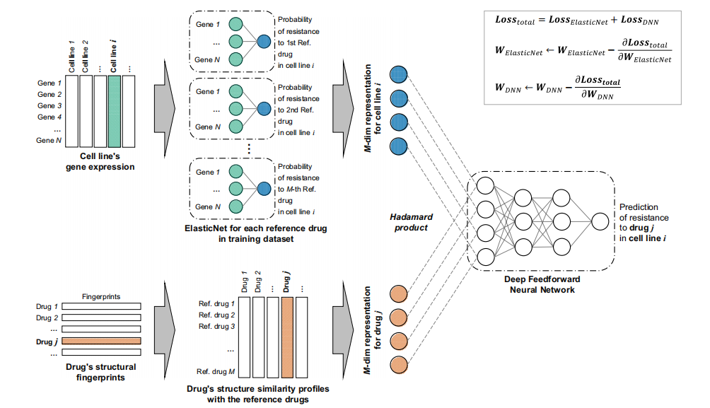
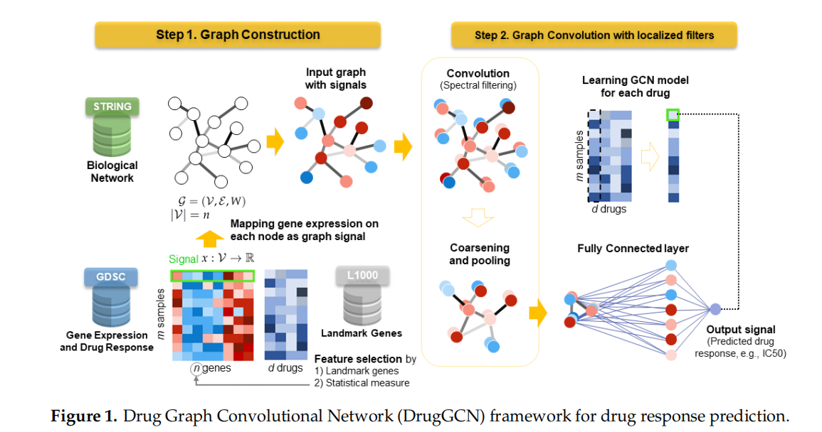
Has anyone studied your kind of problem previously? Which methods were used?
GNN with PPI network (Protein-Protein Network)
RefDNN

Slide 5
What is new in your study?
Considering the signals between the subcell types in sample instead of regrading them as an integraty.
Do not need to train each model for each drug(This is the comparison for the GNN method mentioned)

Slide 6
Why did you choose a certain model/method/algorithm? Which are alternatives?

Slide 7
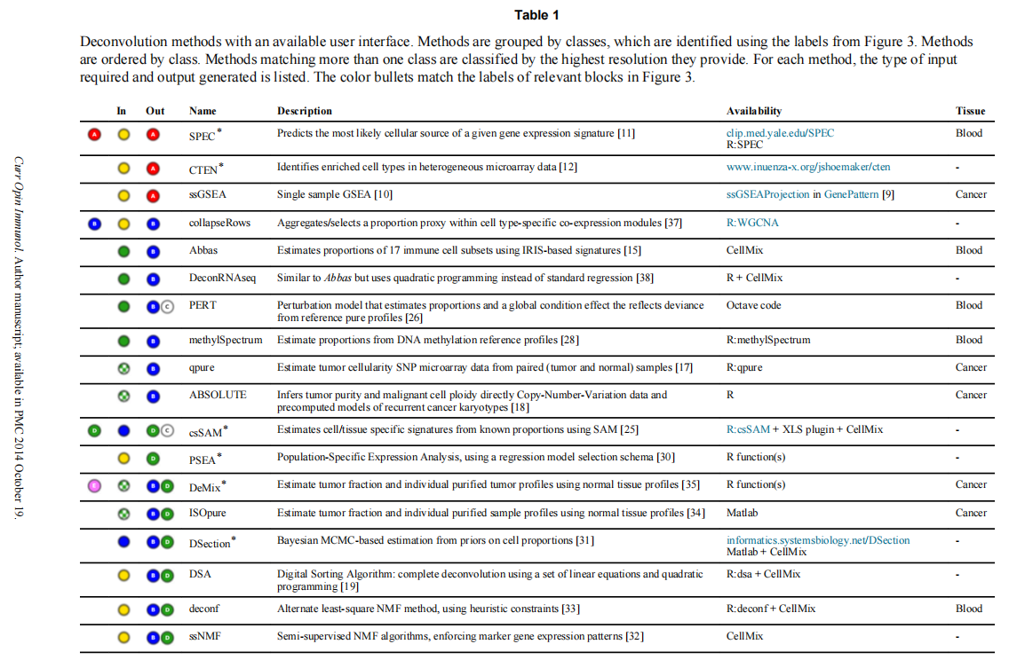
Deconvolution Method

Slide 8
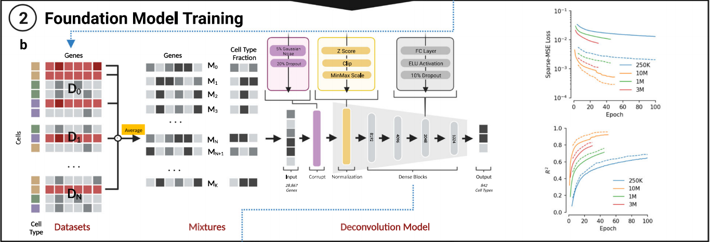
UCDBase model overview
UCDBase is a Deep Neural Network (DNN) with 281,397,066 trainable
parameters that accepts normalized RNA expression input and out puts predicted cell type fractions.

Slide 9
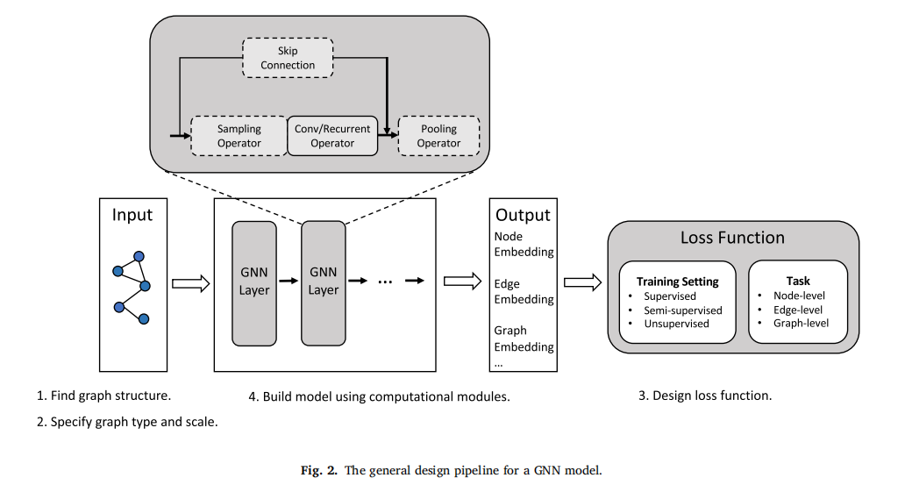
Graph Nueral Network

Slide 10
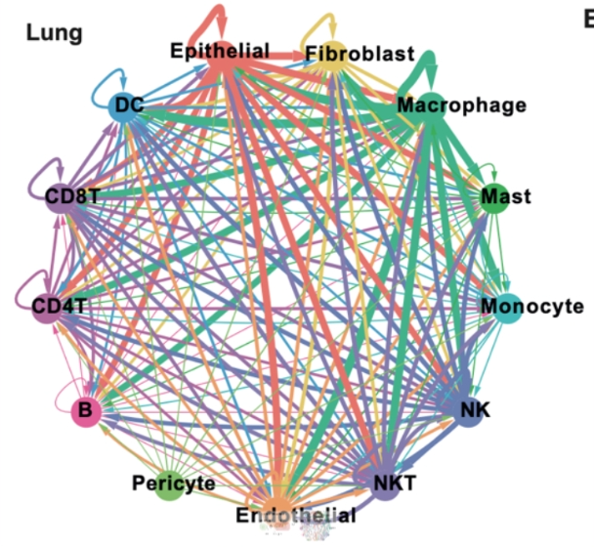
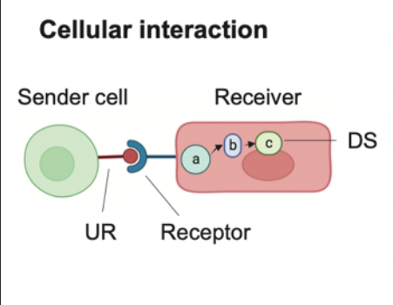
Graph and How Nodes are connected

Slide 11
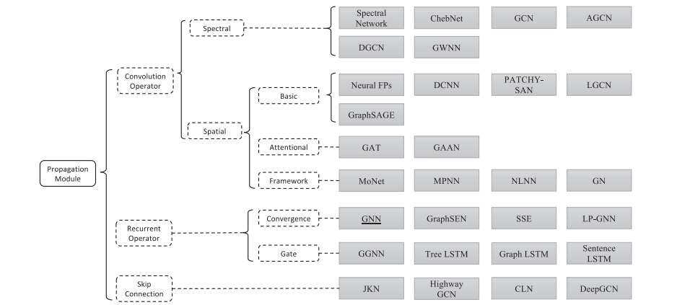
GCN Propagation‑based spatial graph convolutional networks(GraphSAGE)
?

Slide 12
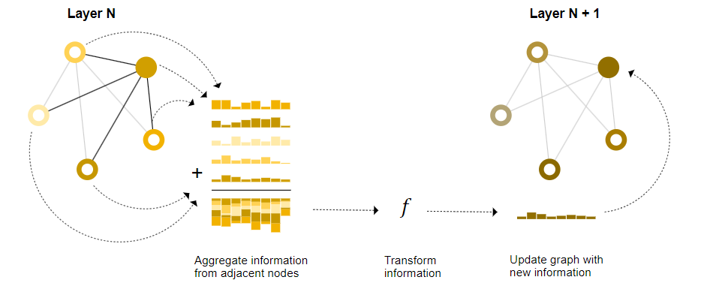
Basic Structure for GCN

Slide 13
About how to get the strength. After getting the gene expressions for cell types, we need to use Nichenet to get the strengh between the cell types.

Slide 14
Thank you!
END

